Slide 1

Code In Place Week 3
Variable Mechanics
Section 299 (Hi Everyone!)
Allen

Slide 2
Getting To Know (lol)
My previous experience in teaching
Briefly introduce yourself!
Name, major (or job position), and a fun fact
How did last section go?
Anything fun in the past week?
Let’s get started!

Slide 3
Week 2 Recap
Control Flows in Python (last Friday’s lecture)
While loops & If statements
Sentinel values
Boolean values
For loops
Examples that puts everything at the same time
Let’s trace the first problem together!
Open Ed lesson page
The ‘Debugging and tracing’ part
Can you spot the bug?

Slide 4
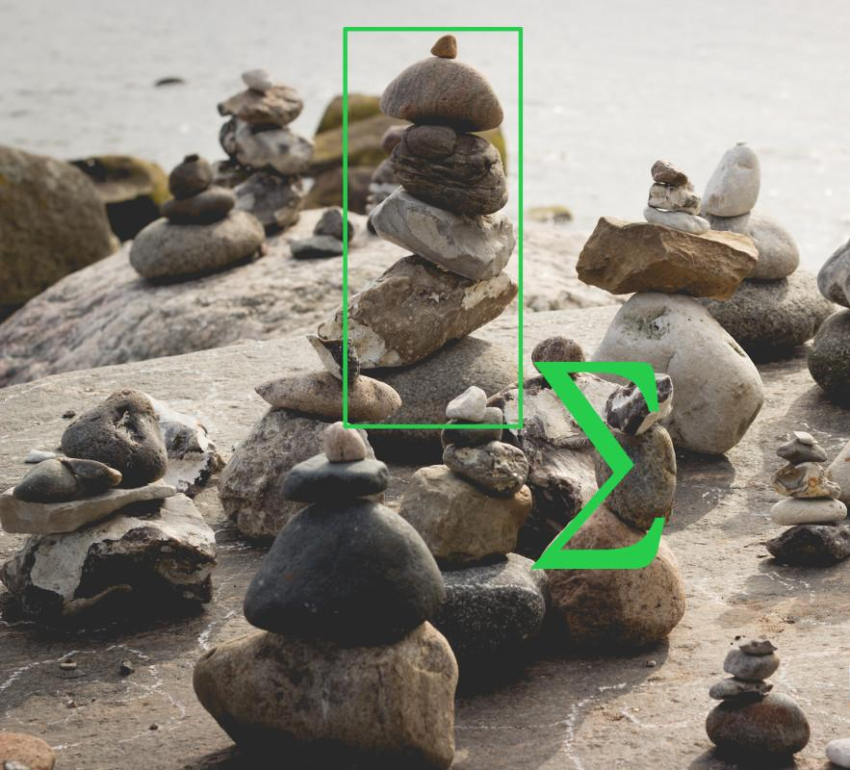
Running Total
Oh..the amount is soaring!
Continue on the Ed lesson
Click on the Running Total problem
I will be writing on my own machine
Feel free to use the Collaborative Workspace!
Breakout Rooms?

Slide 5
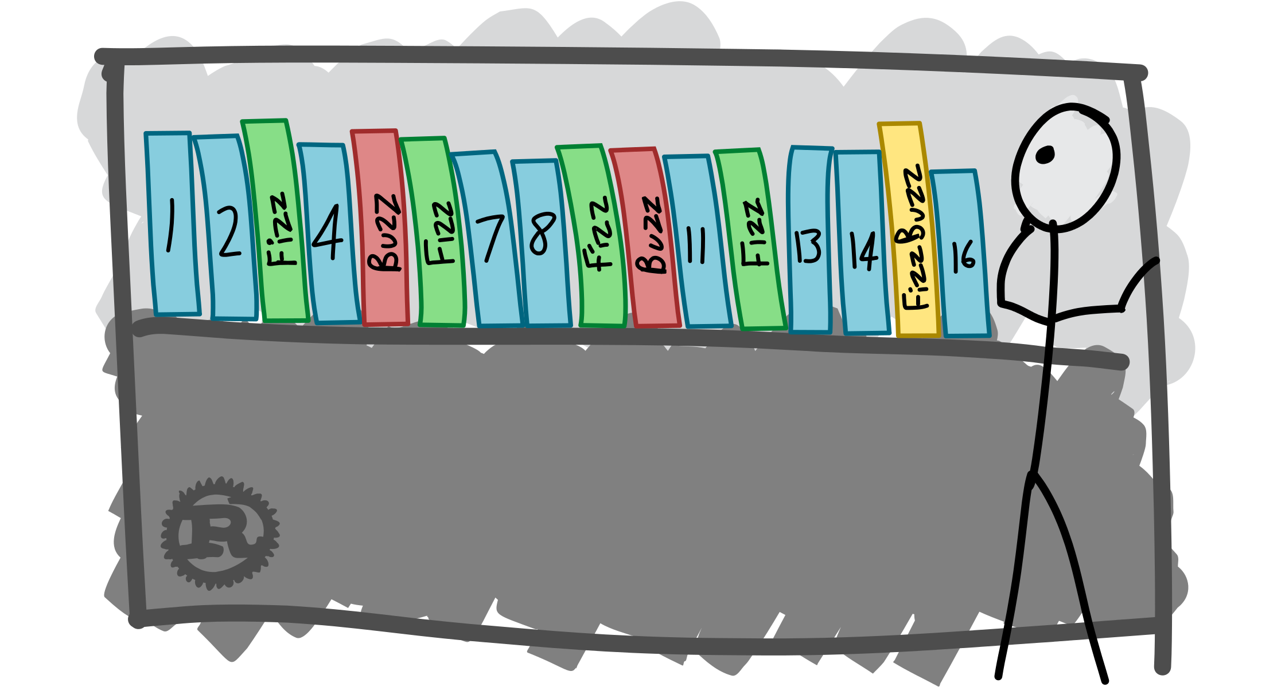
Fizz & Buzz
Fizz..Buzz..is something approaching? (be careful)
Continue on the Ed lesson page
Click on the FizzBuzz problem
I will also be writing on my own machine
Feel free to continue on the Collaborative Workspace
Let’s check up the answers together!

Slide 6
Reminders
Assignment 2 is due on next Monday (5/10) at 11:59pm in your time zone!
Lecture 9 will be released on Friday 5/7
Post a thread in Ed to discuss any confusions or concerns on this week’s materials~
Have a good rest of the week everyone!

Slide 7
Thank You!!
It is so nice of meeting with you guys, even only once! I wish you all the best in the rest of the program!

